Slide 1
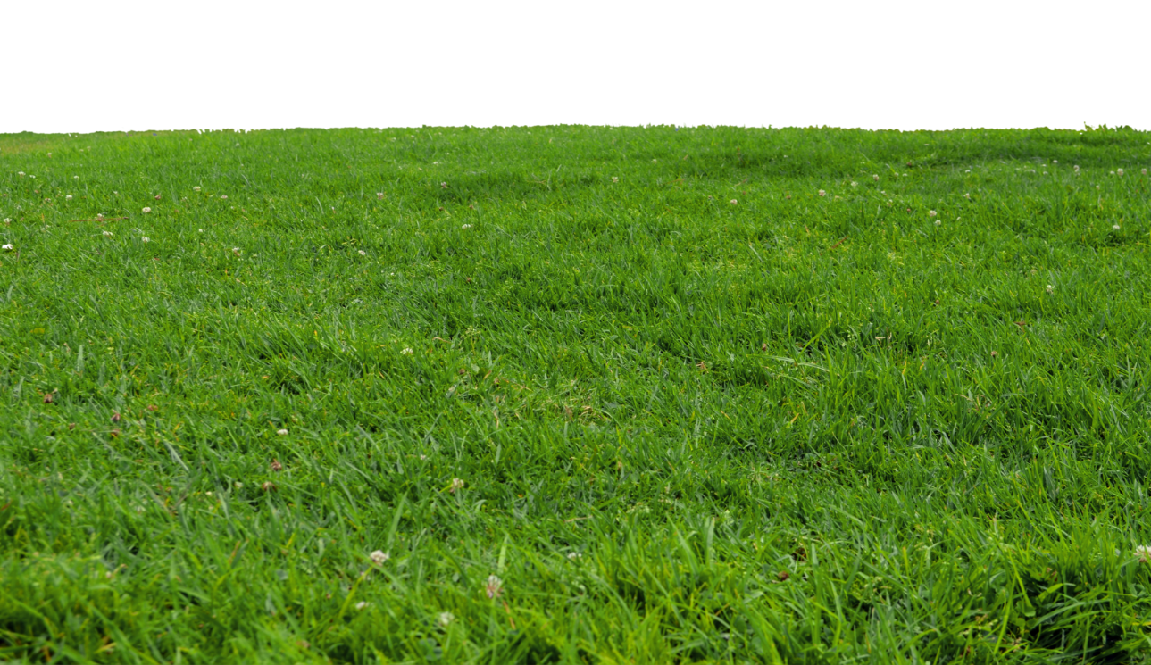
How much fencing do I need for my yard?
9 yards
50 yards
I want to put a fence around my yard so I can get a dog. If my yard measures 50 yards by 9 yards How much fencing will I need to buy?

